Slide 1
Study Environment & Boolean Logic
Study Environment Discussion, Boolean Logic and Functions, Foundational Logic Gates, Hardware Descriptive Languages

Slide 2
Checking in on Project 1
Remember to double-check your submission on GitLab
  Navigate to GitLab, open tags, and verify that the associated commit includes your expected changes
How has Project 1 been coming along?
What questions do you have about Project 1?
Notes:
Make announcement about signing up for your first 1:1 meetings: https://docs.google.com/spreadsheets/d/15lqb4pSZfdDlCLuxKY1GU4HCsWNbZVQ-EcAUcS4dZH4/edit?usp=sharing

Slide 3
Lecture Outline
Study Environment Discussion
Boolean Logic and Functions
  Boolean Expressions, Circuit Diagrams, Truth Tables
  Boolean Function Synthesis Strategy
Hardware Descriptive Languages (HDL)
  HDL Syntax, And Gate Example
Foundational Logic Gates
  Nand, Not, And, Or, Xor, Mux, DMux Gates
  Example of Implementing an Xor Gate in HDL

Slide 4
Study Environment Discussion
In groups of 3-4, discuss the following questions about study environments:
On a typical day, what does your study environment look like? Be specific!
What contributes to an effective study environment? Why?
  What changes can you make to introduce some of these factors?
What factors hinder a study environment from being effective? Why?
  What changes can you make to remove some of these factors?

Slide 5
Lecture Outline
Study Environment Discussion
Boolean Logic and Functions
  Boolean Expressions, Circuit Diagrams, Truth Tables
  Boolean Function Synthesis Strategy
Hardware Descriptive Languages (HDL)
  HDL Syntax, And Gate Example
Foundational Logic Gates
  Nand, Not, And, Or, Xor, Mux, DMux Gates
  Example of Implementing an Xor Gate in HDL

Slide 6


Boolean Values
A binary choice: True or False
Also known as a “low” signal (false, “off,” or 0) and a “high” signal (true, “on”, or 1)
“Off”
False
0
“On”
True
1

Slide 7



Boolean Operations
Use logical operations to combine Boolean values
  Truth table: A table that lists every possible set of inputs and the corresponding output of the operation
  Operations correspond to physical hardware gates
Examples:
A | B | F
0 | 0 | 0
0 | 1 | 0
1 | 0 | 0
1 | 1 | 1
A | B | F
0 | 0 | 0
0 | 1 | 1
1 | 0 | 1
1 | 1 | 1
A | F
0 | 1
1 | 0

Slide 8
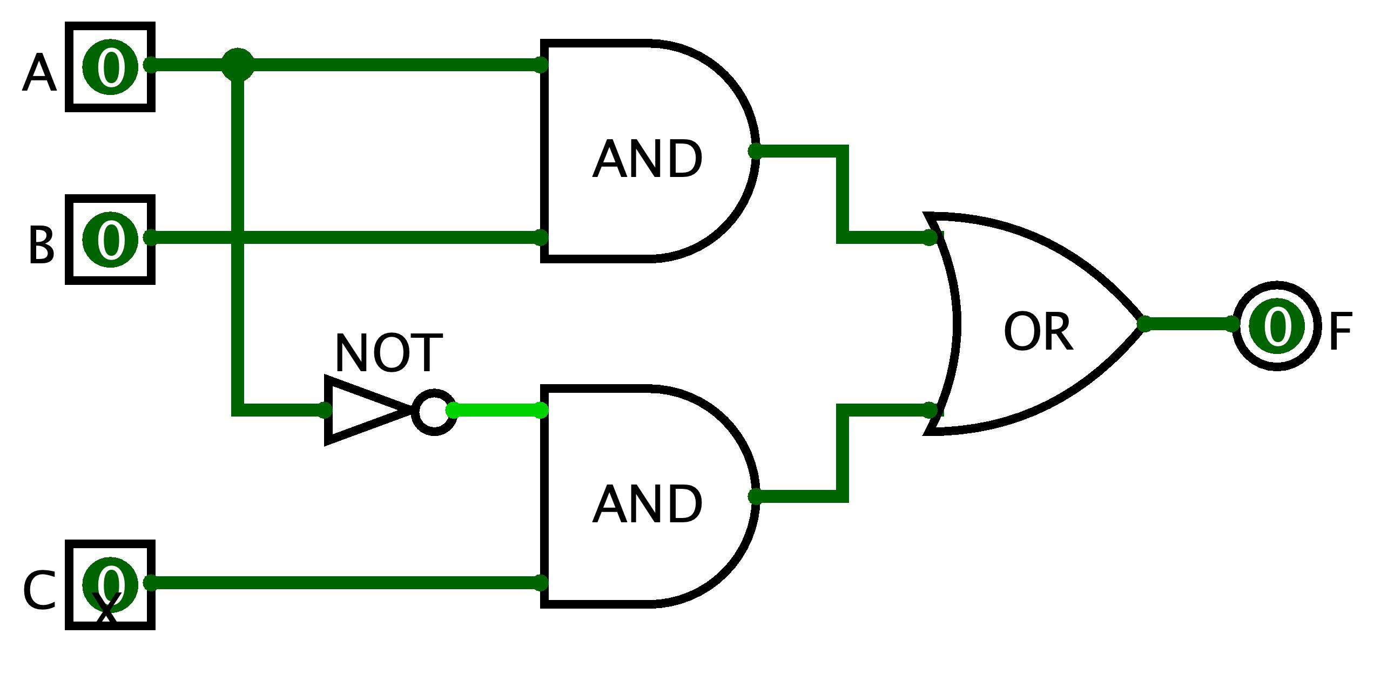
Boolean Functions
Combinations of Boolean inputs resulting in single output
Multiple ways to specify a Boolean function:
  Boolean expression: F = (A AND B) OR (NOT(A) AND C)
  Circuit diagram with logic gates:
  Truth table:
A | B | C | F
0 | 0 | 0 | 0
0 | 0 | 1 | 1
0 | 1 | 0 | 0
0 | 1 | 1 | 1
1 | 0 | 0 | 0
1 | 0 | 1 | 0
1 | 1 | 0 | 1
1 | 1 | 1 | 1

Slide 9
Boolean Expression → Truth Table
We can build a truth table from an expression
  Evaluate the Boolean expression on all possible inputs
F(A, B, C) = (A AND B) OR (NOT(A) AND C)
A | B | C | F
0 | 0 | 0
0 | 0 | 1
0 | 1 | 0
0 | 1 | 1
1 | 0 | 0
1 | 0 | 1
1 | 1 | 0
1 | 1 | 1

Slide 10
Boolean Expression → Truth Table
We can build a truth table from an expression
  Evaluate the Boolean expression on all possible inputs
F(A, B, C) = (A AND B) OR (NOT(A) AND C)
A | B | C | F
0 | 0 | 0 | 0
0 | 0 | 1 | 1
0 | 1 | 0 | 0
0 | 1 | 1 | 1
1 | 0 | 0 | 0
1 | 0 | 1 | 0
1 | 1 | 0 | 1
1 | 1 | 1 | 1

Slide 11
Boolean Expression ← Truth Table
But can we do it in reverse?
F(A, B, C) = (A AND B) OR (NOT(A) AND C)
?
A | B | C | F
0 | 0 | 0 | 0
0 | 0 | 1 | 1
0 | 1 | 0 | 0
0 | 1 | 1 | 1
1 | 0 | 0 | 0
1 | 0 | 1 | 0
1 | 1 | 0 | 1
1 | 1 | 1 | 1

Slide 12
Boolean Expression ← Truth Table
We can describe a single row with AND and NOT
A | B | C | F
0 | 0 | 0 | 0
0 | 0 | 1 | 1
0 | 1 | 0 | 0
0 | 1 | 1 | 1
1 | 0 | 0 | 0
1 | 0 | 1 | 0
1 | 1 | 0 | 1
1 | 1 | 1 | 1

Slide 13
Boolean Expression ← Truth Table
We can describe a single row with AND and NOT
A | B | C | F
0 | 0 | 0 | 0
0 | 0 | 1 | 1 | NOT(A) AND NOT(B) AND C
0 | 1 | 0 | 0
0 | 1 | 1 | 1
1 | 0 | 0 | 0
1 | 0 | 1 | 0
1 | 1 | 0 | 1
1 | 1 | 1 | 1

Slide 14
Boolean Expression ← Truth Table
We can describe a single row with AND and NOT
A | B | C | F
0 | 0 | 0 | 0
0 | 0 | 1 | 1 | NOT(A) AND NOT(B) AND C
0 | 1 | 0 | 0
0 | 1 | 1 | 1 | NOT(A) AND B AND C
1 | 0 | 0 | 0
1 | 0 | 1 | 0
1 | 1 | 0 | 1
1 | 1 | 1 | 1

Slide 15
Boolean Expression ← Truth Table
We can describe a single row with AND and NOT
A | B | C | F
0 | 0 | 0 | 0
0 | 0 | 1 | 1 | NOT(A) AND NOT(B) AND C
0 | 1 | 0 | 0
0 | 1 | 1 | 1 | NOT(A) AND B AND C
1 | 0 | 0 | 0
1 | 0 | 1 | 0
1 | 1 | 0 | 1 | A AND B AND NOT C
1 | 1 | 1 | 1

Slide 16
Boolean Expression ← Truth Table
We can describe a single row with AND and NOT
A | B | C | F
0 | 0 | 0 | 0
0 | 0 | 1 | 1 | NOT(A) AND NOT(B) AND C
0 | 1 | 0 | 0
0 | 1 | 1 | 1 | NOT(A) AND B AND C
1 | 0 | 0 | 0
1 | 0 | 1 | 0
1 | 1 | 0 | 1 | A AND B AND NOT C
1 | 1 | 1 | 1 | A AND B AND C

Slide 17
Boolean Expression ← Truth Table
Then, we can combine the rows using OR operations
F = NOT(A) AND NOT(B) AND C OR NOT(A) AND B AND C OR
A AND B AND NOT C OR A AND B AND C
A | B | C | F
0 | 0 | 0 | 0
0 | 0 | 1 | 1 | NOT(A) AND NOT(B) AND C
0 | 1 | 0 | 0
0 | 1 | 1 | 1 | NOT(A) AND B AND C
1 | 0 | 0 | 0
1 | 0 | 1 | 0
1 | 1 | 0 | 1 | A AND B AND NOT C
1 | 1 | 1 | 1 | A AND B AND C

Slide 18
Boolean Expression ← Truth Table
But can we do it in reverse?
  Yes, we can! The strategy we used is Boolean Function Synthesis
F(A, B, C) = (A AND B) OR (NOT(A) AND C)
✓
A | B | C | F
0 | 0 | 0 | 0
0 | 0 | 1 | 1
0 | 1 | 0 | 0
0 | 1 | 1 | 1
1 | 0 | 0 | 0
1 | 0 | 1 | 0
1 | 1 | 0 | 1
1 | 1 | 1 | 1

Slide 19

Which of the following statements is FALSE?
The Boolean Function Synthesis strategy works on every truth table
In CSE 390B, we will be asking you to write Boolean expressions that must be simplified
The abstraction of voltages on a physical wire represents two values
A truth table lists every possible combination of inputs for a Boolean operation
We’re lost…

Slide 20
Lecture Outline
Study Environment Discussion
Boolean Logic and Functions
  Boolean Expressions, Circuit Diagrams, Truth Tables
  Boolean Function Synthesis Strategy
Hardware Descriptive Languages (HDL)
  HDL Syntax, And Gate Example
Foundational Logic Gates
  Nand, Not, And, Or, Xor, Mux, DMux Gates
  Example of Implementing an Xor Gate in HDL

Slide 21
Hardware Design Language (HDL)
HDL is a programming language to specify hardware components and how they’re connected
  Another way of describing a Boolean function!
Many Hardware Design Languages are used today
  E.g., VHDL, Verilog, SystemVerilog
  In this course, we’ll use a simple HDL language called “HDL”
Unlike Java, HDL is a declarative language. This means the following:
  The order of statements (lines of code) doesn’t matter
  We are describing a physical system

Slide 22
Hardware Design Language (HDL)
Format of an HDL file
  File comment describes expected behavior
  IN names chip inputs, OUT names chip outputs
  PARTS specify the components (i.e., other gates) that implement the chip
/**
* And gate:
* out = 1 only if both a and b are 1
*/
CHIP And {
  IN a, b;
  OUT out;
  PARTS:
  // Put your code here:
  }

Slide 23
Reusing Components
You can (and should!) use chips you have already implemented to implement subsequent chips
We give you one gate, Nand, to start out with
  Implication: The entire computer you will be building will be use Nand gates as its foundation
We also provide you with some chips you can use without implementing

Slide 24
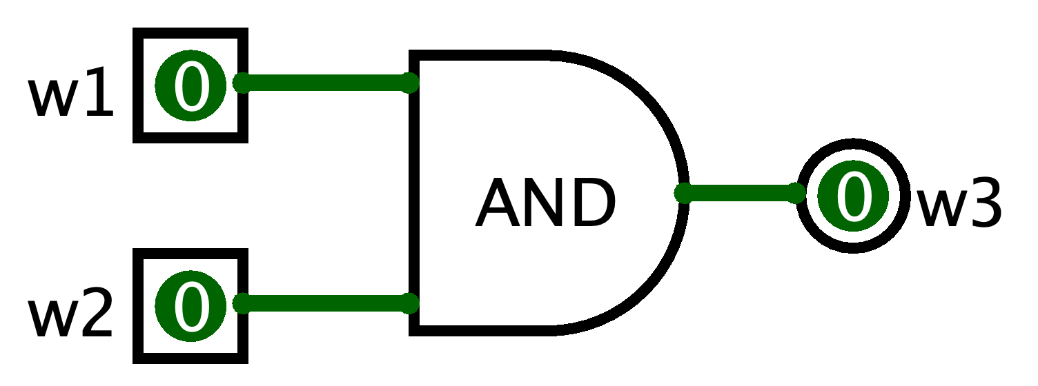
HDL Component Example: AND
The chip specification tells us the name of the input and output wires
Goal: Implement w1 AND w2
  HDL Syntax for using (being a client of the And gate): And(a=w1, b=w2, out=w3);
  Equivalent circuit diagram:
CHIP And {
  IN a, b;
  OUT out;
  ...
  }
a
b
out

Slide 25
Multi-bit Buses in HDL
It can be useful to manipulate groups of wires
  Called a “bus” of wires
HDL provides array like syntax for manipulating buses
  And4 chip example:
/**
* Bit-wise And of two 4-bit inputs
*/
CHIP And4 {
IN a[4], b[4];
OUT out[4];
PARTS:
And (a=a[0], b=b[0], out=out[0]);
And (a=a[1], b=b[1], out=out[1]);
And (a=a[2], b=b[2], out=out[2]);
And (a=a[3], b=b[3], out=out[3]);
}

Slide 26
HDL Resources
HDL will feel unfamiliar at first, and that’s okay
Resources for helping you navigate HDL linked under the Resources page on the course website
  HDL Survival guide
  Appendix A (HDL Spec)
  Chip Set Overview (to help you remember the inputs/outputs for various chips)
  Chapter readings

Slide 27
Lecture Outline
Study Environment Discussion
Boolean Logic and Functions
  Boolean Expressions, Circuit Diagrams, Truth Tables
  Boolean Function Synthesis Strategy
Hardware Descriptive Languages (HDL)
  HDL Syntax, And Gate Example
Foundational Logic Gates
  Nand, Not, And, Or, Xor, Mux, DMux Gates
  Example of Implementing an Xor Gate in HDL

Slide 28


The Foundational Building Block
It all starts with the NAND gate
NAND is short for “Not And”
  The same output as the AND gate, but every output bit is negated (flipped)
A | B | F
0 | 0 | 0
0 | 1 | 0
1 | 0 | 0
1 | 1 | 1
A | B | F
0 | 0 | 1
0 | 1 | 1
1 | 0 | 1
1 | 1 | 0

Slide 29
Building Gates From Nand
Recall the Boolean Function Synthesis strategy from today’s reading
  We saw how we can represent any truth table in terms of three gates: Not, And, Or
First, we can represent Not directly from Nand
  Not a = a Nand a
Then, we can represent And in terms of Not and Nand
  a And b = Not(a Nand b)
Represent Or in terms of Not and And
  Apply De Morgan’s Law
  a Or b = Not(Not(a) And Not(b)) [De Morgan’s Law]

Slide 30
Making Decisions in Hardware
We write if/else statements in Java with the understanding that only one of the branches will run
  For example, in the following code, we expect to compute one of a & b or a | b (not both)
In hardware, the entire circuit is always executing
  We can’t “turn off” a part of a circuit based on a condition
  Instead, we create circuits for different conditions and choose which output based on a condition instead
if (c == 0) {
out = a & b;
} else {
out = a | b;
}

Slide 31
Decisions in Hardware: Mux Gate
We can use a Multiplexer (Mux) gate to choose which singular input to output
  Takes three inputs: a, b, and sel
  If sel == 0, then out = a
  Otherwise, out = b
Mux Gate Truth Table:
a
0
Mux
out
b
1
sel
a | b | sel | F
0 | 0 | 0 | 0
0 | 0 | 1 | 0
0 | 1 | 0 | 0
0 | 1 | 1 | 1
1 | 0 | 0 | 1
1 | 0 | 1 | 0
1 | 1 | 0 | 1
1 | 1 | 1 | 1

Slide 32
Decisions in Hardware: DMux Gate
A Demultiplexer (DMux) gate passes one input to one of two outputs and 0 to the rest
  Takes two inputs: in and sel
  If sel == 0, then a = in and b = 0
  Otherwise, a = 0 and b = in
DMux Gate Truth Table:
a
0
in
DMux
1
b
sel
in | sel | a | b
0 | 0 | 0 | 0
0 | 1 | 0 | 0
1 | 0 | 1 | 0
1 | 1 | 0 | 1

Slide 33
Implementing an Xor Gate: Overview
Let’s walk through an example of building a gate that you will work on in Project 2, the Xor gate
Together, we’ll implement the Xor gate
/**
* Xor gate:
* out = not(a == b)
*/
CHIP Xor {
  IN a, b;
  OUT out;
  PARTS:
  // Put your code here:
  }

Slide 34
Implementing an Xor Gate: Overview
Plan of action:
  Step 1: Create the logic operation’s truth table
  Step 2: Use truth table to generate a Boolean function using strategies we’ve learned, such as the Boolean Function Synthesis
  Step 3: Convert Boolean function to HDL
/**
* Xor gate:
* out = not(a == b)
*/
CHIP Xor {
  IN a, b;
  OUT out;
  PARTS:
  // Put your code here:
  }

Slide 35

Implementing an Xor Gate: Step 1
Step 1: Create the truth table for Xor
  Interpret the specification: F = NOT(A == B)
A | B | F
0 | 0
0 | 1
1 | 0
1 | 1

Slide 36
Implementing an Xor Gate: Step 1
Step 1: Create the truth table for Xor
  Interpret the specification: F = NOT(A == B)
A | B | F
0 | 0 | 0
0 | 1 | 1
1 | 0 | 1
1 | 1 | 0

Slide 37

Implementing an Xor Gate: Step 2
Step 2: Use truth table to generate a Boolean function
  Let’s use the Boolean Function Synthesis strategy from the reading
  Row 2 = NOT(A) AND B
A | B | F
0 | 0 | 0 | (Row 1)
0 | 1 | 1 | (Row 2)
1 | 0 | 1 | (Row 3)
1 | 1 | 0 | (Row 4)

Slide 38
Implementing an Xor Gate: Step 2
Step 2: Use truth table to generate a Boolean function
  Let’s use the Boolean Function Synthesis strategy from the reading
  Row 2 = NOT(A) AND B
  Row 3 = A AND NOT(B)
A | B | F
0 | 0 | 0 | (Row 1)
0 | 1 | 1 | (Row 2)
1 | 0 | 1 | (Row 3)
1 | 1 | 0 | (Row 4)

Slide 39
Implementing an Xor Gate: Step 2
Step 2: Use truth table to generate a Boolean function
  Let’s use the Boolean Function Synthesis strategy from the reading
  Row 2 = NOT(A) AND B
  Row 3 = A AND NOT(B)
  F = ?
A | B | F
0 | 0 | 0 | (Row 1)
0 | 1 | 1 | (Row 2)
1 | 0 | 1 | (Row 3)
1 | 1 | 0 | (Row 4)

Slide 40
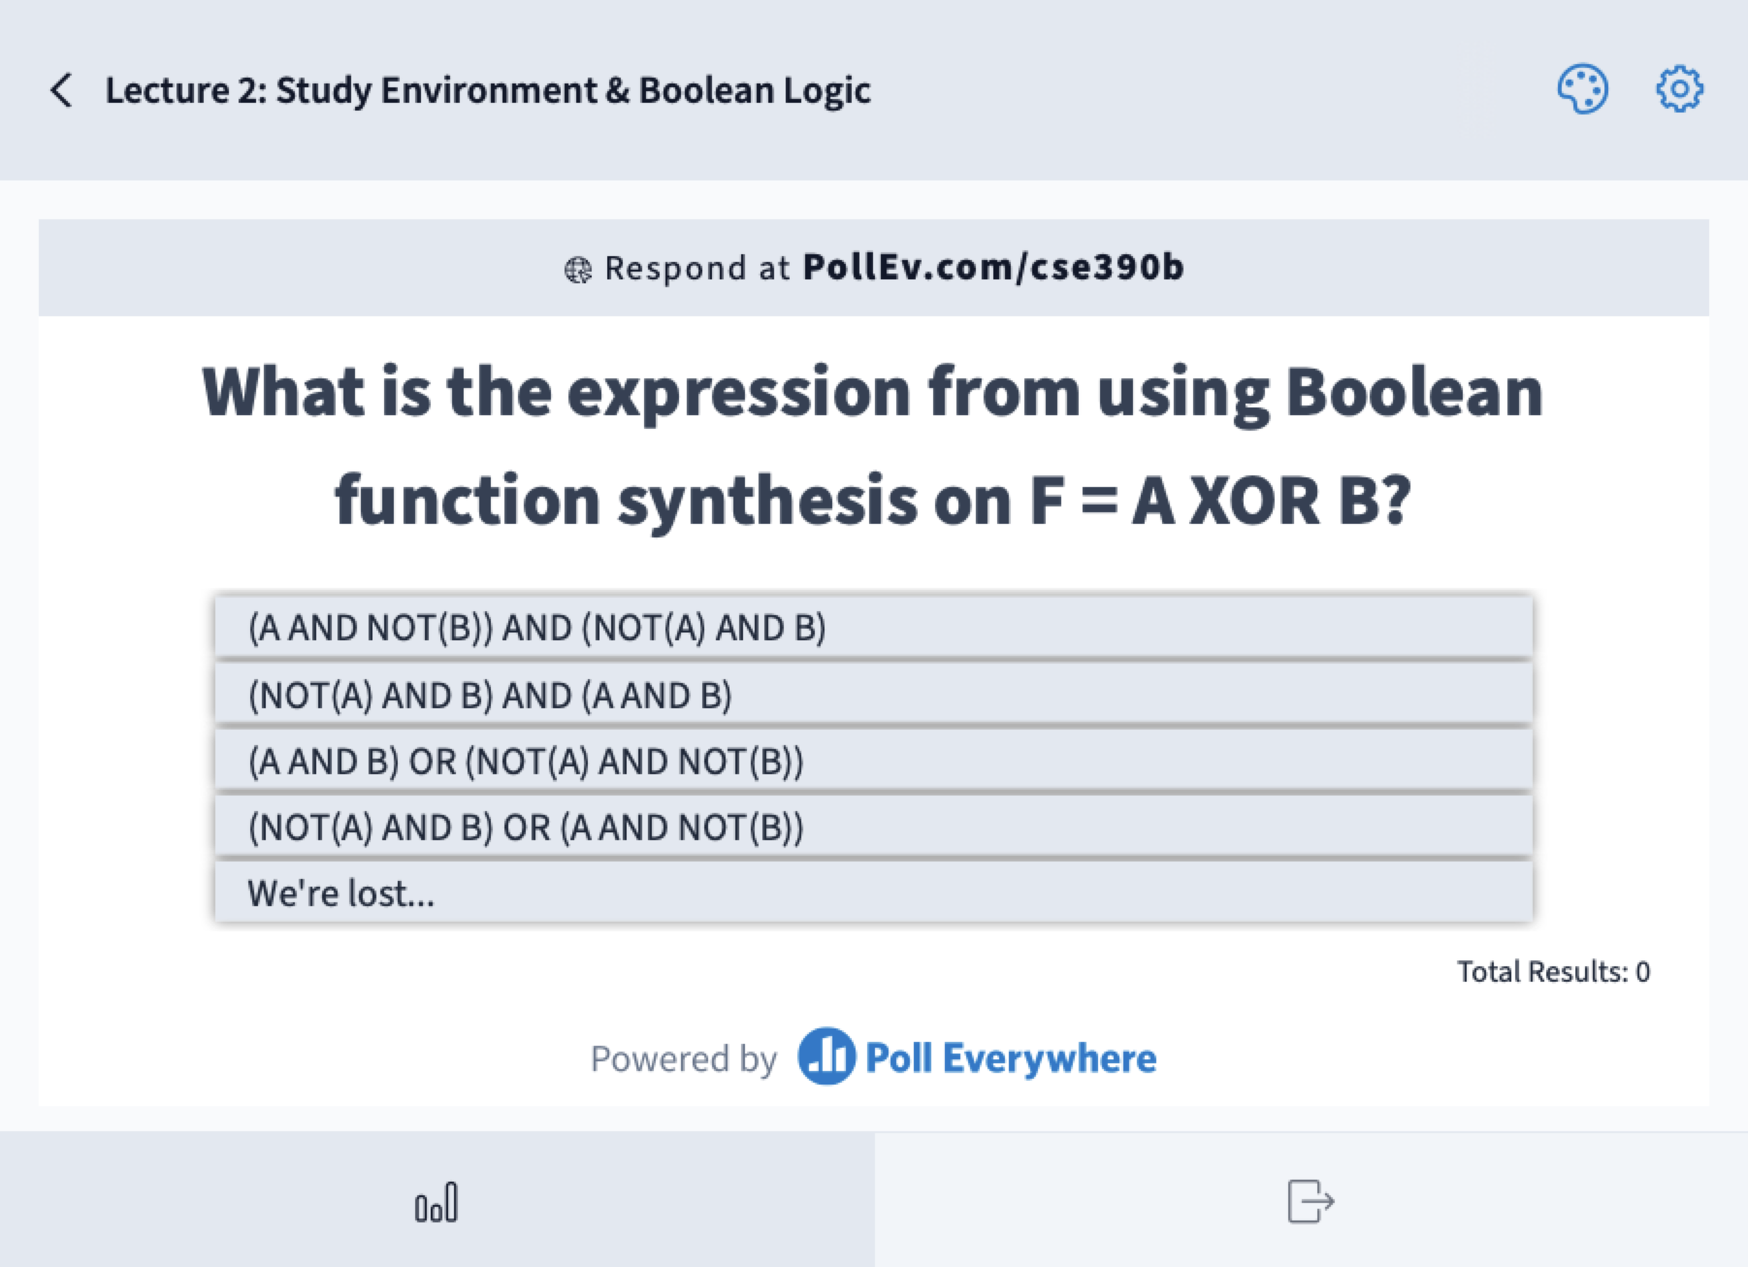
What is the unsimplified Boolean expression result from performing Boolean function synthesis on F = A XOR B?
  (A AND NOT(B)) AND (NOT(A) AND B)
  (NOT(A) AND B) AND (A AND B)
  (A AND B) OR (NOT(A) AND NOT(B))
  (NOT(A) AND B) OR (A AND NOT(B))
  We’re lost…
A | B | F = A XOR B
0 | 0 | 0 | (Row 1)
0 | 1 | 1 | (Row 2)
1 | 0 | 1 | (Row 3)
1 | 1 | 0 | (Row 4)
  Row 2 = NOT(A) AND B
  Row 3 = A AND NOT(B)

Slide 41
Implementing an Xor gate: Step 2
Step 2: Use truth table to generate a Boolean function
  Let’s use the Boolean function synthesis strategy from the reading
  Row 2 = NOT(A) AND B
  Row 3 = A AND NOT(B)
  F = Row 2 OR Row 3
  = (NOT(A) AND B) OR (A AND NOT(B))
A | B | F
0 | 0 | 0 | (Row 1)
0 | 1 | 1 | (Row 2)
1 | 0 | 1 | (Row 3)
1 | 1 | 0 | (Row 4)

Slide 42
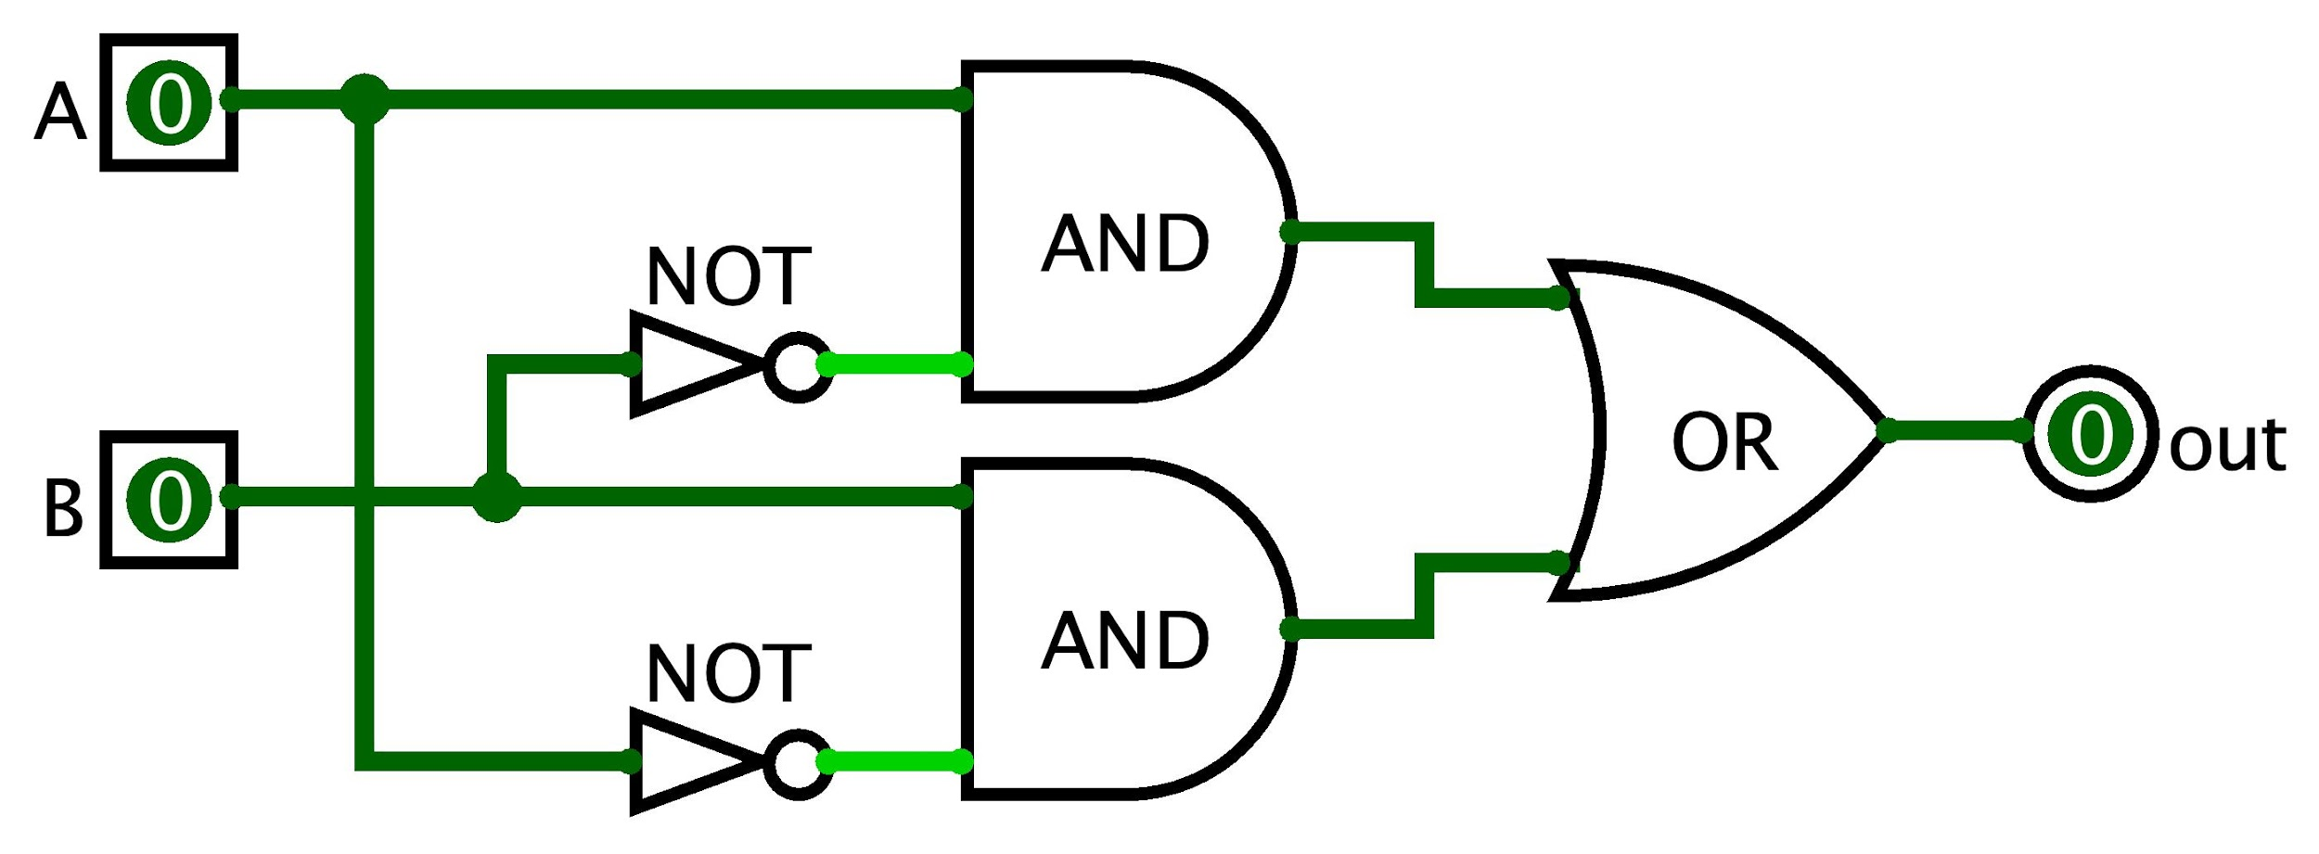
Implementing an Xor gate: Step 3
Now that we have a Boolean expression, we can implement the Xor gate in HDL
Optionally, it can help to express the Boolean expression as a circuit diagram
A XOR B = (NOT(A) AND B) OR (A AND NOT(B))

Slide 43
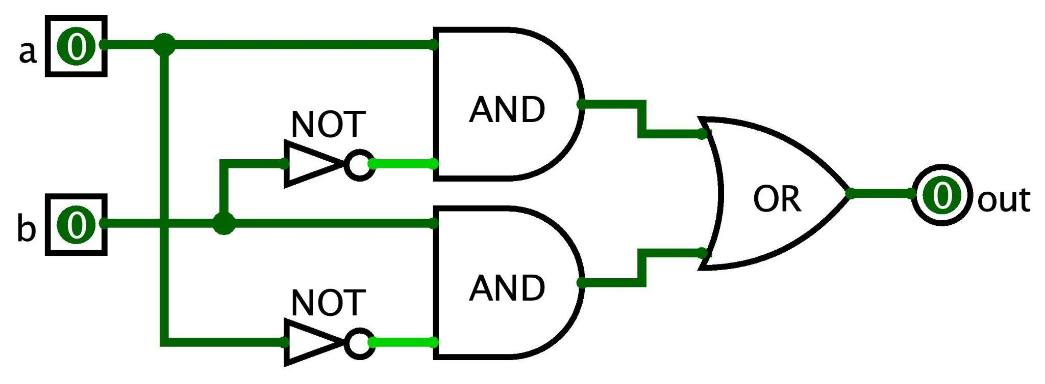
Implementing an Xor gate: Step 3
Step 3: Convert Boolean function to HDL syntax
  A XOR B = (NOT(A) AND B) OR (A AND NOT(B))
  Assumes Not, And, and Or are already implemented
  Note the use of intermediary wires: nota, notb, x, and y
CHIP Xor {
  IN a, b;
  OUT out;
  PARTS:
  Not (in=a, out=nota);
  Not (in=b, out=notb);
  And (a=a, b=notb, out=x);
  And (a=nota, b=b, out=y);
  Or (a=x, b=y, out=out);
  }

Slide 44
Project 2 Overview
Metacognitive Component: Study Skills Inventory
  Reflect on your academic behaviors, strategies, and practices
  You will be graded on completing the form, not your responses
  This activity is for your own benefit, and the more honest you are, the more beneficial it will be
Technical Component: GitLab Setup
  Will help prepare you for future CSE 390B projects
Estimated time to complete: 6-8 hours
Project 2 is released and will be due next Thursday (1/12) at 11:59pm

Slide 45
Post-Lecture 2 Reminders
Project 1 due tonight (1/5) at 11:59pm
Project 2 (Study Skills Inventory & Boolean Logic) released today, due next Thursday (1/12) at 11:59pm
Eric has office hours after class in CSE2 153
First Student-TA meetings starting next week
  Your TA will be in contact with you about the first meeting

